Slide 1

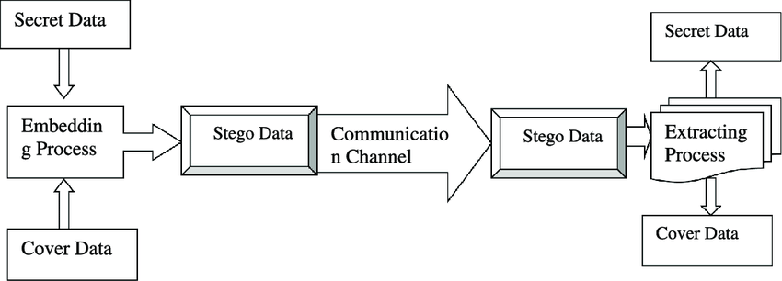

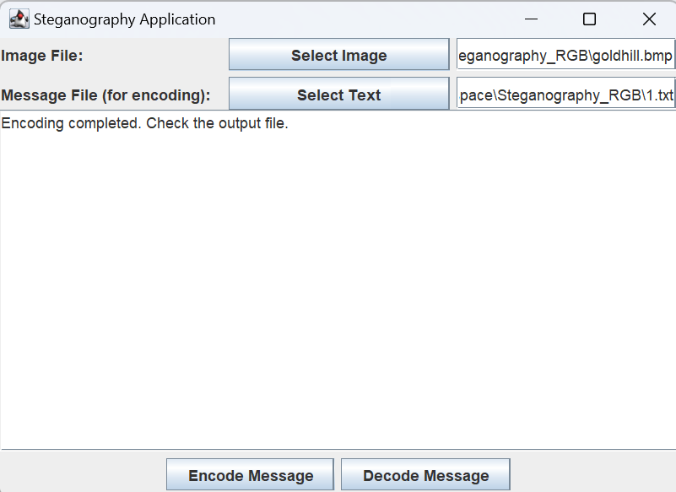
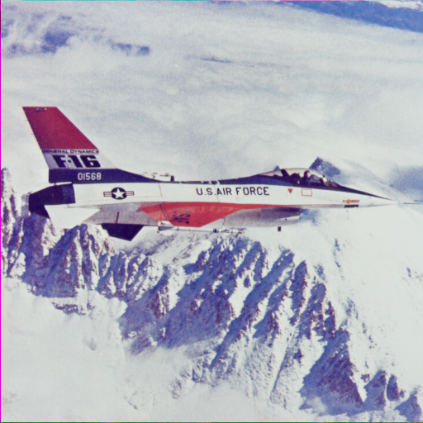
Digital Steganography
CS 4485/Fall 2024
Department of Computer Science
Erik Jonsson School of Engineering & Computer Science
The University of Texas at Dallas
Richardson, TX 75080, USA
Obed Lastick Collin Tran Jordan Scott Eman Abu-Ali Kenneth Vo
Goal: Create an interface for users to encode text-based messages into an image and then be able to decode the contents of the image without distorting the original image state while researching encryption techniques
Approach:
Text Message
Text Message
Java GUI
encodeST.java
- LSB Technique on RGB values of pixels
decodeST.java
- Reading the LSB of RGB channels from pixels
Image (.png, .bmp, .tiff)
Image (.png, .bmp, .tiff)
Encoded Image
Key Features:
Original
Supports .png, .bmp, and .tiff image file types
Comprehensive UI page to easily encode and decode messages to/from images
Notifies you of maximum message size limit before encoding
Minimal Distortion

